Slide 2
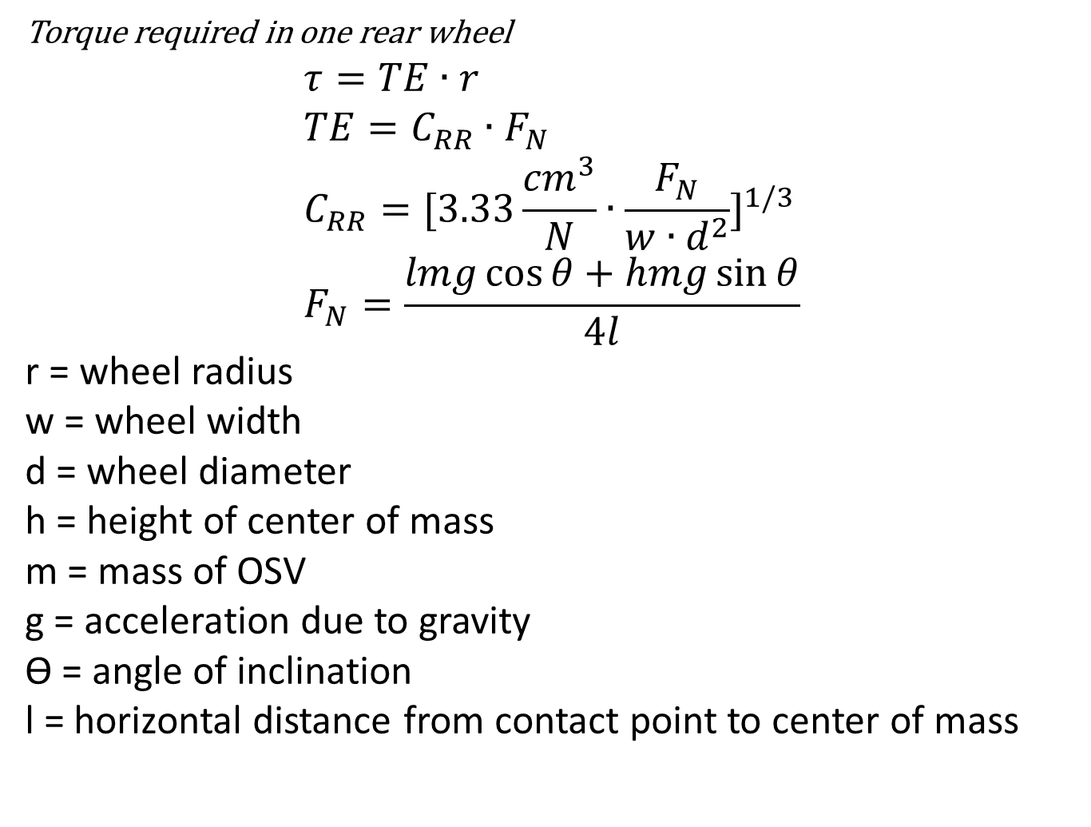
Torque required in one rear wheel $$τ=TE∙r \\ TE=C_{RR}∙F_{N} \\ C_{RR}={[3.33\frac{{cm}^{3}}{N}∙\frac{F_{N}}{w∙d^{2}}]}^{1/3} \\ F_{N}=\frac{lmg\cos{θ}+hmg\sin{θ}}{4l}$$ r = wheel radius w = wheel width d = wheel diameter h = height of center of mass m = mass of OSV g = acceleration due to gravity ϴ = angle of inclination l = horizontal distance from contact point to center of mass

Slide 3
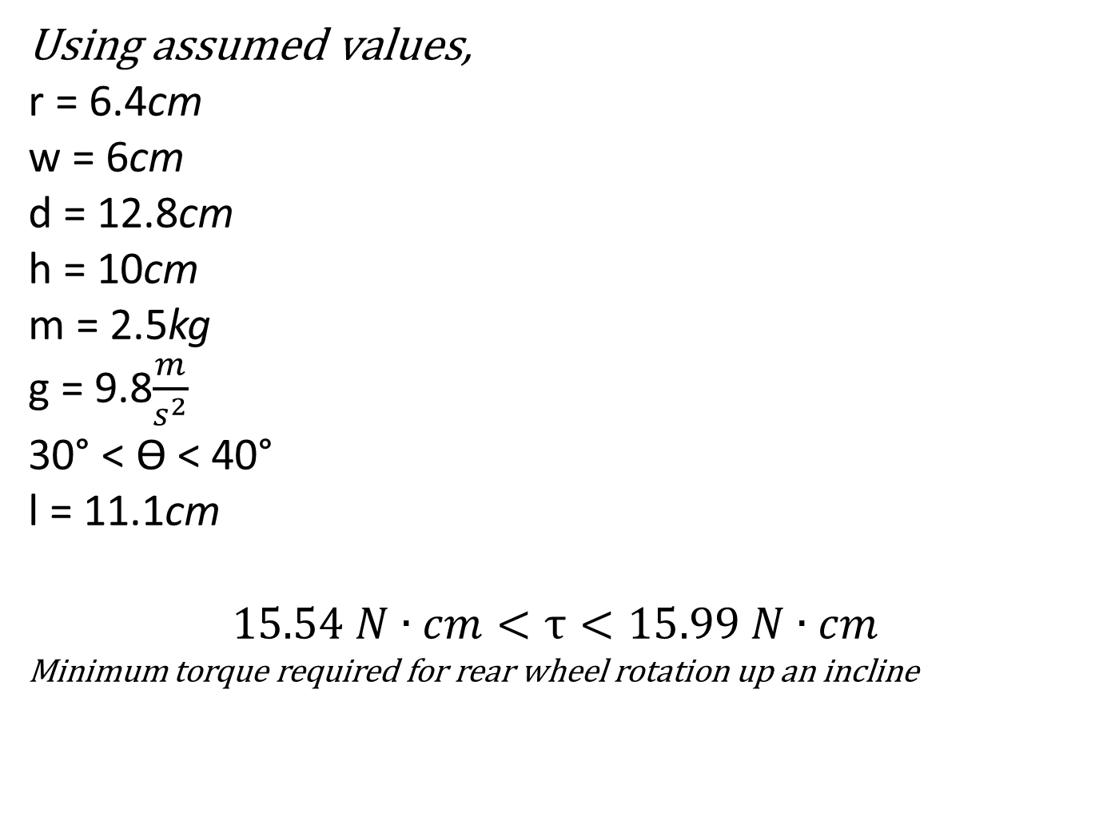
Using assumed values, r = 6.4cm w = 6cm d = 12.8cm h = 10cm m = 2.5kg g = 9.8$\frac{m}{s^{2}}$ 30° < ϴ < 40° l = 11.1cm $$15.54 N∙cm<τ<15.99 N∙cm$$ Minimum torque required for rear wheel rotation up an incline

Slide 4
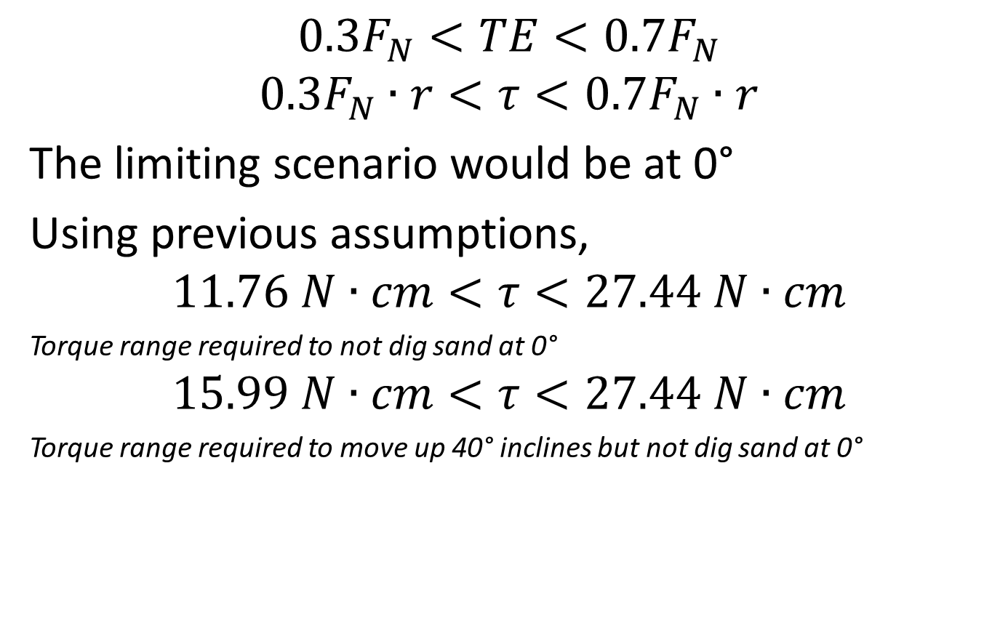
Avoiding The Dig
$$0.3F_{N}<TE<0.7F_{N}$$
$$0.3F_{N}∙r<τ<0.7F_{N}∙r$$
The limiting scenario would be at 0°
Using previous assumptions,
$$11.76 N∙cm<τ<27.44 N∙cm$$
Torque range required to not dig sand at 0°
$$15.99 N∙cm<τ<27.44 N∙cm$$
Torque range required to move up 40° inclines but not dig sand at 0°

